Slide 1
Real Utopias
Erik Olin Wright
University of Wisconsin – Madison
Denison College
April 2014

Slide 2
Introduction
The Problem
We live in a world in which capitalism generates enormous harms and yet to most people it seems like the only way of organizing a complex economic system.

Slide 3
Introduction
Clash of Slogans
“There is No Alternative”
Margaret Thatcher, early 1980s
“Another World is Possible”
World Social Forum, early 2000s

Slide 4
Introduction
Clash of Slogans
“There is No Alternative”
Margaret Thatcher, early 1980s
“Another World is Possible”
World Social Forum, early 2000s

Slide 5
Introduction
Clash of Slogans
“There is No Alternative”
Margaret Thatcher, early 1980s
“Another World is Possible”
World Social Forum, early 2000s

Slide 6
Introduction
Alternatives as “Real Utopias”
Utopia: Alternatives to dominant institutions that embody our deepest aspirations for a just and humane world.
Real: Alternatives that can be built in the world as it is that also prefigure the world as it could be.

Slide 7
Introduction
Four tasks of an
Emancipatory Social Science
    Moral Foundations
    Diagnosis & Critique
    3. Alternatives
    4. Transformation

Slide 8
Task 1. Moral Foundations
Principles
Equality: In a just society all persons would have broadly equal access to the material and social means necessary to live a flourishing life.
Democracy: In a fully democratic society, all people would have broadly equal access to the necessary means to participate meaningfully in decisions about things which affect their lives.
Community/Solidarity: Community/solidarity expresses the principle that people ought to cooperate with each other not simply because what they personally get out of it, but also out of a real commitment to the wellbeing of others.
Sustainability: Future generations should have access to the social and material means to live flourishing lives at least at the same level as the present generation.

Slide 9
Task 1. Moral Foundations
Principles
Equality: In a just society all persons would have broadly equal access to the material and social means necessary to live a flourishing life.
Democracy: In a fully democratic society, all people would have broadly equal access to the necessary means to participate meaningfully in decisions about things which affect their lives.
Community/Solidarity: Community/solidarity expresses the principle that people ought to cooperate with each other not simply because what they personally get out of it, but also out of a real commitment to the wellbeing of others.
Sustainability: Future generations should have access to the social and material means to live flourishing lives at least at the same level as the present generation.

Slide 10
Task 1. Moral Foundations
Principles
Equality: In a just society all persons would have broadly equal access to the material and social means necessary to live a flourishing life.
Democracy: In a fully democratic society, all people would have broadly equal access to the necessary means to participate meaningfully in decisions about things which affect their lives.
Community/Solidarity: Community/solidarity expresses the principle that people ought to cooperate with each other not simply because what they personally get out of it, but also out of a real commitment to the wellbeing of others.
Sustainability: Future generations should have access to the social and material means to live flourishing lives at least at the same level as the present generation.

Slide 11
Task 1. Moral Foundations
Principles
Equality: In a just society all persons would have broadly equal access to the material and social means necessary to live a flourishing life.
Democracy: In a fully democratic society, all people would have broadly equal access to the necessary means to participate meaningfully in decisions about things which affect their lives.
Community/Solidarity: Community/solidarity expresses the principle that people ought to cooperate with each other not simply because what they personally get out of it, but also out of a real commitment to the wellbeing of others.
Sustainability: Future generations should have access to the social and material means to live flourishing lives at least at the same level as the present generation.

Slide 12
Task 1. Moral Foundations
Principles
Equality: In a just society all persons would have broadly equal access to the material and social means necessary to live a flourishing life.
Democracy: In a fully democratic society, all people would have broadly equal access to the necessary means to participate meaningfully in decisions about things which affect their lives.
Community/Solidarity: Community/solidarity expresses the principle that people ought to cooperate with each other not simply because what they personally get out of it, but also out of a real commitment to the wellbeing of others.
Sustainability: Future generations should have access to the social and material means to live flourishing lives at least at the same level as the present generation.

Slide 13
Task 2. Diagnosis & Critique
Diagnosis & Critique of Capitalism
Equality: Capitalism perpetuates eliminable forms of human suffering and deficits in human flourishing. It inherently generates levels of inequality in income and wealth that systematically violate social justice.
Democracy: Capitalism generates severe deficits in realizing democratic values by excluding crucial decisions from public deliberation, by allowing private wealth to affect access to political power, and by allowing workplace dictatorships.
Community/Solidarity: Competition and commodification within capitalism undermine community/solidarity.
Sustainability: Capitalism inherently threatens the quality of the environment for future generations because of imperatives for consumerism and endless growth.

Slide 14
Task 2. Diagnosis & Critique
Diagnosis & Critique of Capitalism
Equality: Capitalism perpetuates eliminable forms of human suffering and deficits in human flourishing. It inherently generates levels of inequality in income and wealth that systematically violate social justice.
Democracy: Capitalism generates severe deficits in realizing democratic values by excluding crucial decisions from public deliberation, by allowing private wealth to affect access to political power, and by allowing workplace dictatorships.
Community/Solidarity: Competition and commodification within capitalism undermine community/solidarity.
Sustainability: Capitalism inherently threatens the quality of the environment for future generations because of imperatives for consumerism and endless growth.

Slide 15
Task 2. Diagnosis & Critique
Diagnosis & Critique of Capitalism
Equality: Capitalism perpetuates eliminable forms of human suffering and deficits in human flourishing. It inherently generates levels of inequality in income and wealth that systematically violate social justice.
Democracy: Capitalism generates severe deficits in realizing democratic values by excluding crucial decisions from public deliberation, by allowing private wealth to affect access to political power, and by allowing workplace dictatorships.
Community/Solidarity: Competition and commodification within capitalism undermine community/solidarity.
Sustainability: Capitalism inherently threatens the quality of the environment for future generations because of imperatives for consumerism and endless growth.

Slide 16
Task 2. Diagnosis & Critique
Diagnosis & Critique of Capitalism
Equality: Capitalism perpetuates eliminable forms of human suffering and deficits in human flourishing. It inherently generates levels of inequality in income and wealth that systematically violate social justice.
Democracy: Capitalism generates severe deficits in realizing democratic values by excluding crucial decisions from public deliberation, by allowing private wealth to affect access to political power, and by allowing workplace dictatorships.
Community/Solidarity: Competition and commodification within capitalism undermine community/solidarity.
Sustainability: Capitalism inherently threatens the quality of the environment for future generations because of imperatives for consumerism and endless growth.

Slide 17
Task 2. Diagnosis & Critique
Diagnosis & Critique of Capitalism
Equality: Capitalism perpetuates eliminable forms of human suffering and deficits in human flourishing. It inherently generates levels of inequality in income and wealth that systematically violate social justice.
Democracy: Capitalism generates severe deficits in realizing democratic values by excluding crucial decisions from public deliberation, by allowing private wealth to affect access to political power, and by allowing workplace dictatorships.
Community/Solidarity: Competition and commodification within capitalism undermine community/solidarity.
Sustainability: Capitalism inherently threatens the quality of the environment for future generations because of imperatives for consumerism and endless growth.

Slide 18
Task 3. Alternatives
Examples of Real Utopias

Slide 19
Production
Worker cooperatives, solidarity cooperatives, union cooperatives
Peer-to-peer collaborative production: Wikipedia, open-source software
Urban agriculture with community land trusts
Finance
Solidarity finance
Crowd-sourced financing of projects
Alternative currencies: local currencies, labor time banks
Distribution
Open-access intellectual property: creative commons, copy-left
Internet-based gift-economy in music
Free Publicly provided goods/services: libraries, free public transport
Unconditional basic income
Democracy
Participatory budgeting
The Quebec social economy council
Policy juries and “randomocracy”
Community and the Environment
Ecovillages, Transition towns, intentional communities

Slide 20
Production
Worker cooperatives, solidarity cooperatives, union cooperatives
Peer-to-peer collaborative production: Wikipedia, open-source software
Urban agriculture with community land trusts
Finance
Solidarity finance
Crowd-sourced financing of projects
Alternative currencies: local currencies, labor time banks
Distribution
Open-access intellectual property: creative commons, copy-left
Internet-based gift-economy in music
Free Publicly provided goods/services: libraries, free public transport
Unconditional basic income
Democracy
Participatory budgeting
The Quebec social economy council
Policy juries and “randomocracy”
Community and the Environment
Ecovillages, Transition towns, intentional communities

Slide 21


http://justcoffee.coop/

Slide 22
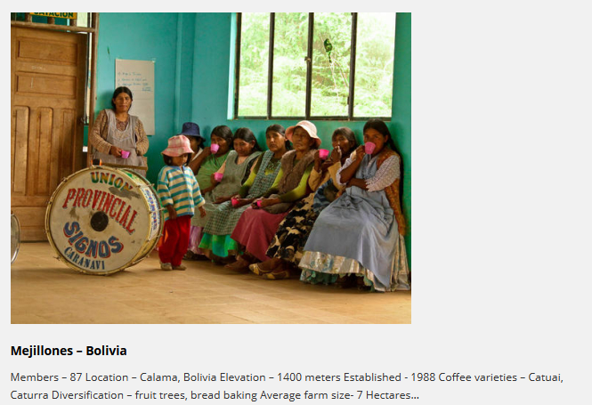

Slide 23
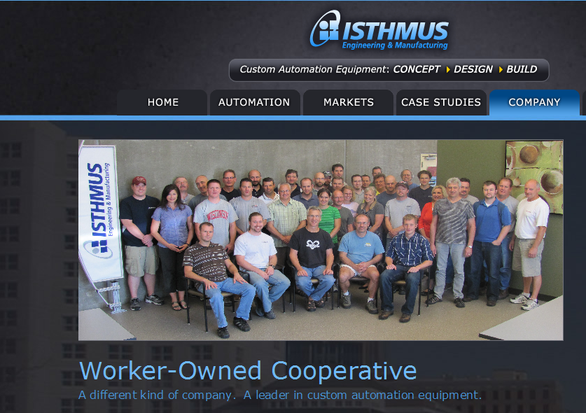

Slide 24
Production
Worker cooperatives, solidarity cooperatives, union cooperatives
Peer-to-peer collaborative production: Wikipedia, open-source software
Urban agriculture with community land trusts
Finance
Solidarity finance
Crowd-sourced financing of projects
Alternative currencies: local currencies, labor time banks
Distribution
Open-access intellectual property: creative commons, copy-left
Internet-based gift-economy in music
Free Publicly provided goods/services: libraries, free public transport
Unconditional basic income
Democracy
Participatory budgeting
The Quebec social economy council
Policy juries and “randomocracy”
Community and the Environment
Ecovillages, Transition towns, intentional communities

Slide 25
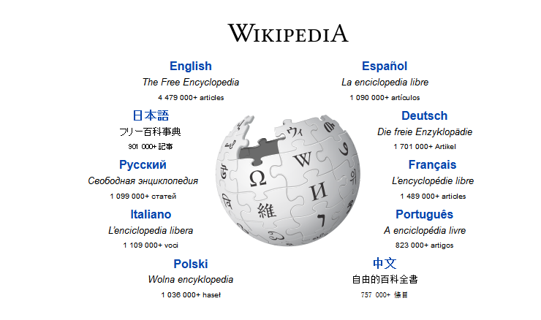

Slide 26


Tux, The Linux Penguin Mascot

Slide 27
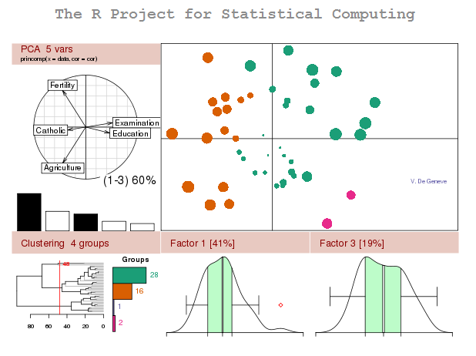


Slide 28
Production
Worker cooperatives, solidarity cooperatives, union cooperatives
Peer-to-peer collaborative production: Wikipedia, open-source software
Urban agriculture with community land trusts
Finance
Solidarity finance
Crowd-sourced financing of projects
Alternative currencies: local currencies, labor time banks
Distribution
Open-access intellectual property: creative commons, copy-left
Internet-based gift-economy in music
Free Publicly provided goods/services: libraries, free public transport
Unconditional basic income
Democracy
Participatory budgeting
The Quebec social economy council
Policy juries and “randomocracy”
Community and the Environment
Ecovillages, Transition towns, intentional communities

Slide 29

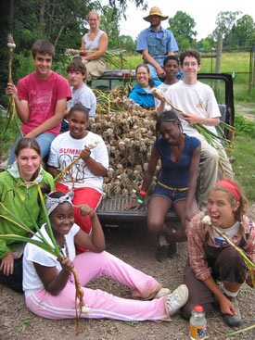
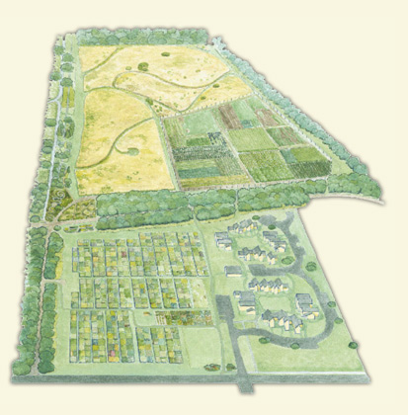
http://www.communitygroundworks.org/

Slide 30
Production
Worker cooperatives, solidarity cooperatives, union cooperatives
Peer-to-peer collaborative production: Wikipedia, open-source software
Urban agriculture with community land trusts
Finance
Solidarity finance
Crowd-sourced financing of projects
Alternative currencies: local currencies, labor time banks
Distribution
Open-access intellectual property: creative commons, copy-left
Internet-based gift-economy in music
Free Publicly provided goods/services: libraries, free public transport
Unconditional basic income
Democracy
Participatory budgeting
The Quebec social economy council
Policy juries and “randomocracy”
Community and the Environment
Ecovillages, Transition towns, intentional communities

Slide 31
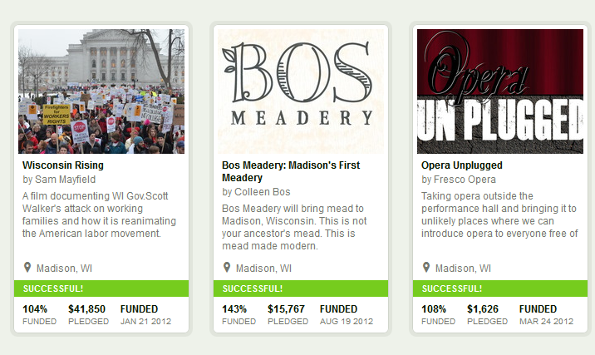
Some Kickstarter crowd sourcing projects in Madison, Wi
https://www.kickstarter.com/

Slide 32


Slide 33
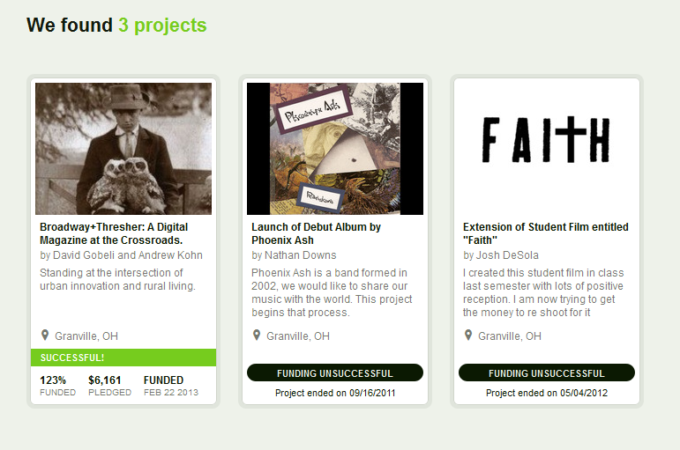
Kickstarter projects in Granville, Ohio

Slide 34
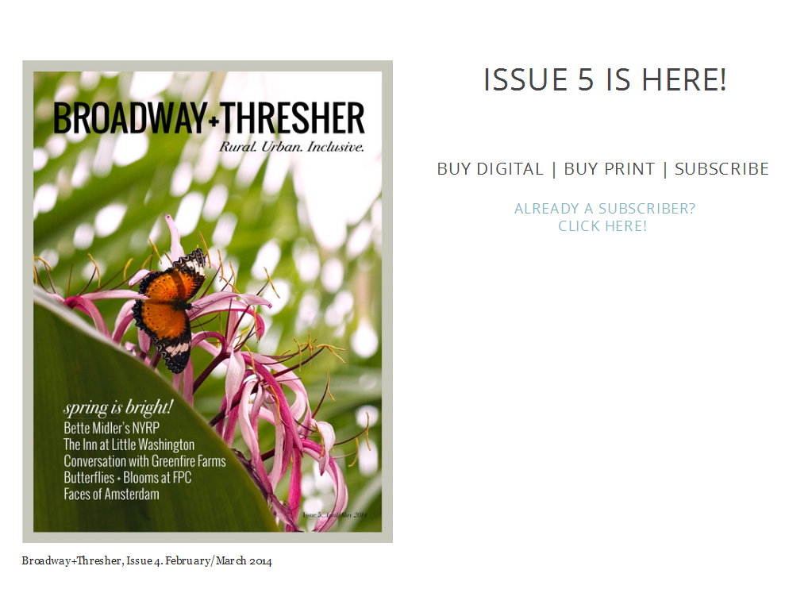

Slide 35
Production
Worker cooperatives, solidarity cooperatives, union cooperatives
Peer-to-peer collaborative production: Wikipedia, open-source software
Urban agriculture with community land trusts
Finance
Solidarity finance
Crowd-sourced financing of projects
Alternative currencies: local currencies, labor time banks
Distribution
Open-access intellectual property: creative commons, copy-left
Internet-based gift-economy in music
Free Publicly provided goods/services: libraries, free public transport
Unconditional basic income
Democracy
Participatory budgeting
The Quebec social economy council
Policy juries and “randomocracy”
Community and the Environment
Ecovillages, Transition towns, intentional communities

Slide 36
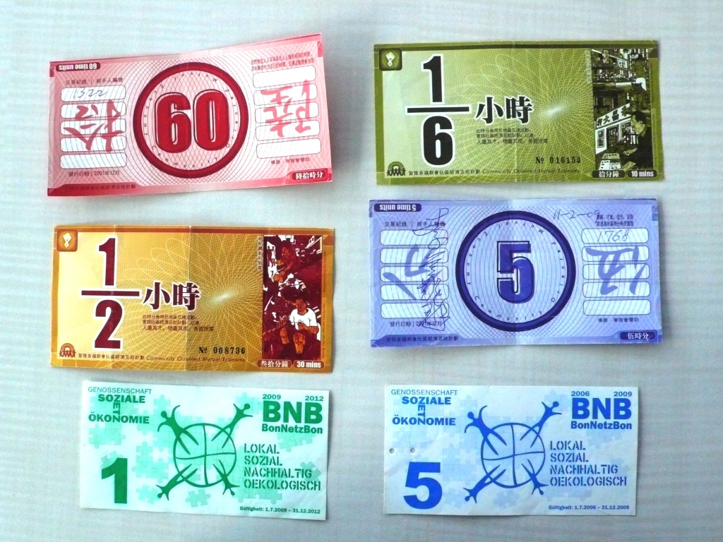
Task 3. Alternatives

Slide 37
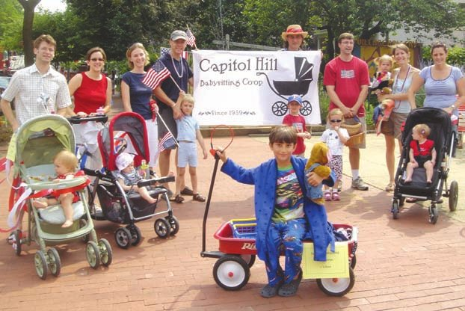
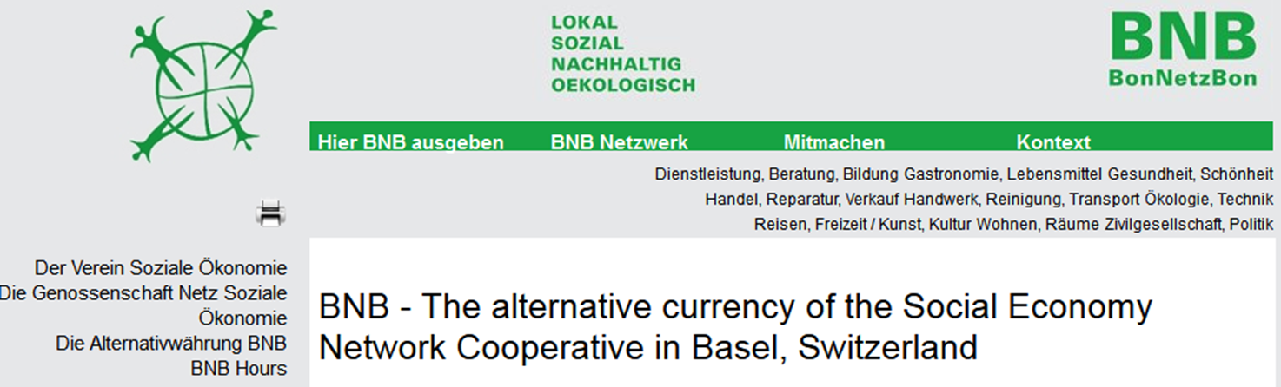
Capitol Hill babysitting coop with alternative time-scrip currency
http://viavia.ch/bnb/pmwiki.php?n=Betriebe.HomePage

Slide 38
Production
Worker cooperatives, solidarity cooperatives, union cooperatives
Peer-to-peer collaborative production: Wikipedia, open-source software
Urban agriculture with community land trusts
Finance
Solidarity finance
Crowd-sourced financing of projects
Alternative currencies: local currencies, labor time banks
Distribution
Open-access intellectual property: creative commons, copy-left
Internet-based gift-economy in music
Free Publicly provided goods/services: libraries, free public transport
Unconditional basic income
Democracy
Participatory budgeting
The Quebec social economy council
Policy juries and “randomocracy”
Community and the Environment
Ecovillages, Transition towns, intentional communities

Slide 39


http://creativecommons.org/choose/

Slide 40
Production
Worker cooperatives, solidarity cooperatives, union cooperatives
Peer-to-peer collaborative production: Wikipedia, open-source software
Urban agriculture with community land trusts
Finance
Solidarity finance
Crowd-sourced financing of projects
Alternative currencies: local currencies, labor time banks
Distribution
Open-access intellectual property: creative commons, copy-left
Internet-based gift-economy in music
Free Publicly provided goods/services: libraries, free public transport
Unconditional basic income
Democracy
Participatory budgeting
The Quebec social economy council
Policy juries and “randomocracy”
Community and the Environment
Ecovillages, Transition towns, intentional communities

Slide 41
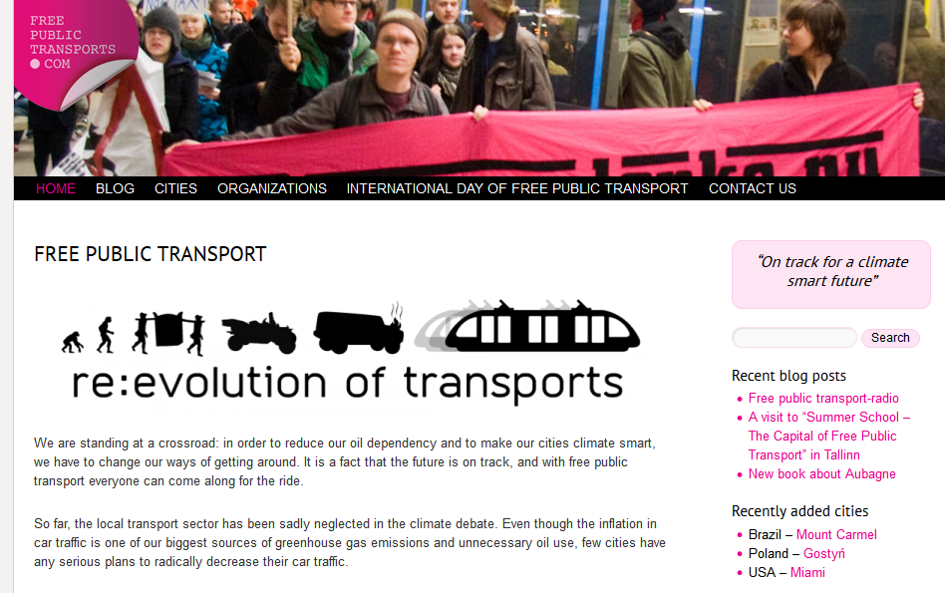
http://freepublictransports.com/

Slide 42
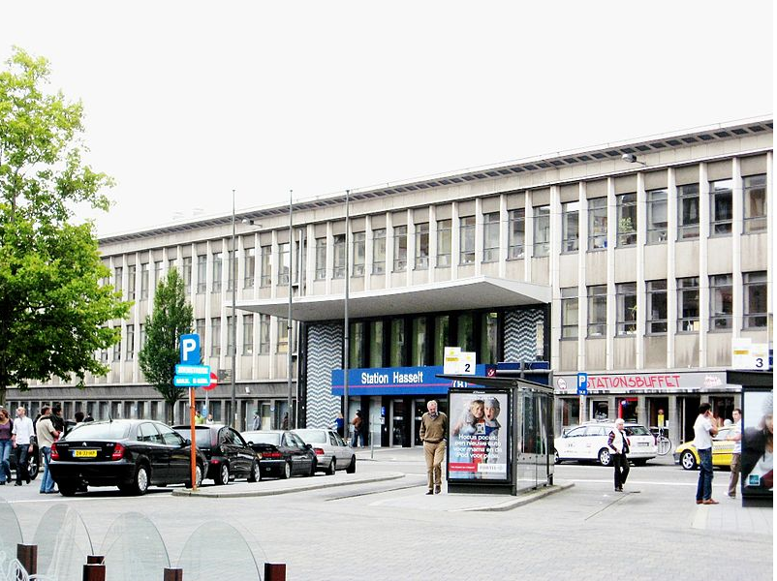
No-Fare Public Transportation in Hasselt, Netherlands
introduced July, 1997

Slide 43
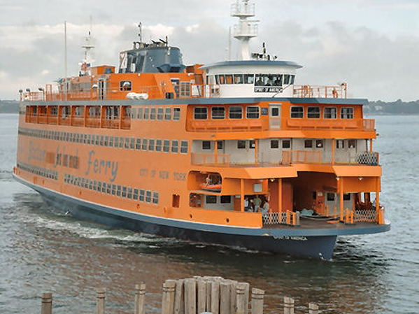
Staten Island Ferry: free public transport

Slide 44
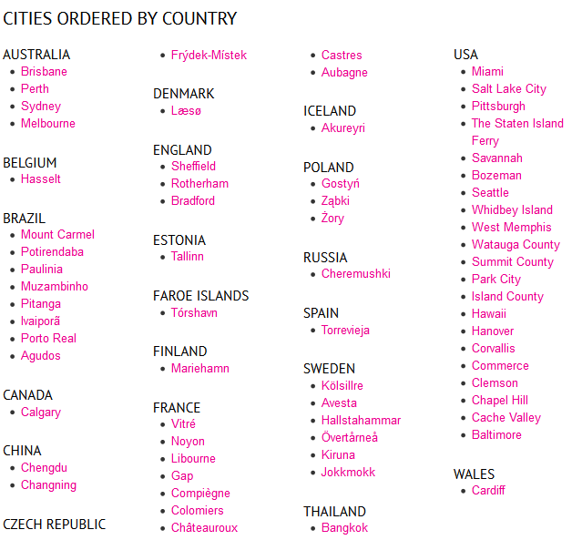
Cities with free public transportation
http://freepublictransports.com/city/

Slide 45
Production
Worker cooperatives, solidarity cooperatives, union cooperatives
Peer-to-peer collaborative production: Wikipedia, open-source software
Urban agriculture with community land trusts
Finance
Solidarity finance
Crowd-sourced financing of projects
Alternative currencies: local currencies, labor time banks
Distribution
Open-access intellectual property: creative commons, copy-left
Internet-based gift-economy in music
Free Publicly provided goods/services: libraries, free public transport
Unconditional basic income
Democracy
Participatory budgeting
The Quebec social economy council
Policy juries and “randomocracy”
Community and the Environment
Ecovillages, Transition towns, intentional communities

Slide 46



http://www.basicincome2013.eu/en/index.html

Slide 47
Production
Worker cooperatives, solidarity cooperatives, union cooperatives
Peer-to-peer collaborative production: Wikipedia, open-source software
Urban agriculture with community land trusts
Finance
Solidarity finance
Crowd-sourced financing of projects
Alternative currencies: local currencies, labor time banks
Distribution
Open-access intellectual property: creative commons, copy-left
Internet-based gift-economy in music
Free Publicly provided goods/services: libraries, free public transport
Unconditional basic income
Democracy
Participatory budgeting
The Quebec social economy council
Policy juries and “randomocracy”
Community and the Environment
Ecovillages, Transition towns, intentional communities

Slide 48
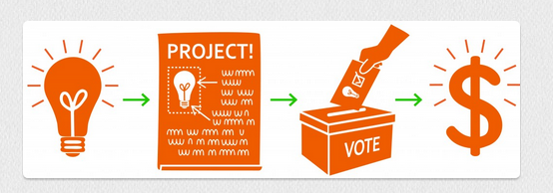
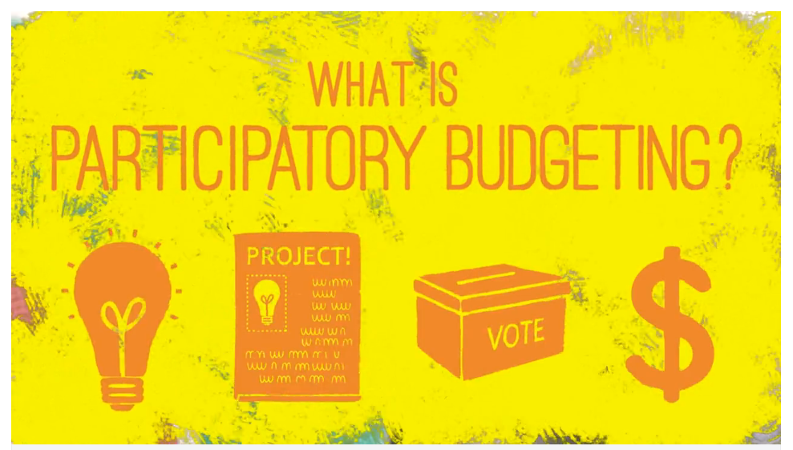
Laptop link
http://vimeo.com/71975359

Slide 49
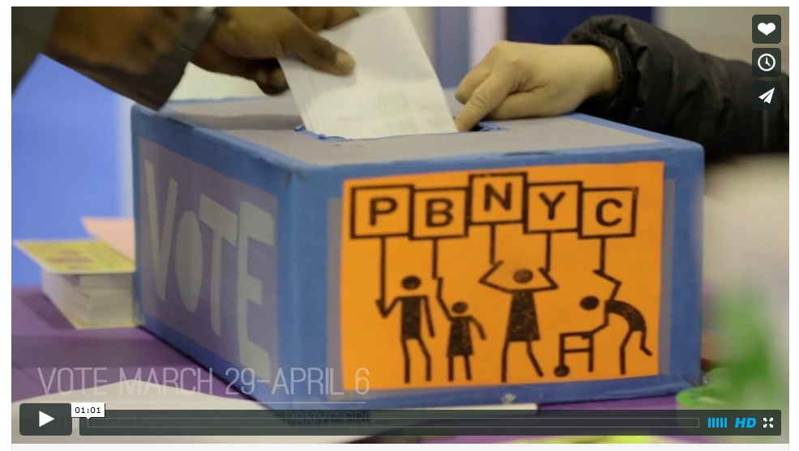
Link
http://vimeo.com/89366699

Slide 50
Production
Worker cooperatives, solidarity cooperatives, union cooperatives
Peer-to-peer collaborative production: Wikipedia, open-source software
Urban agriculture with community land trusts
Finance
Solidarity finance
Crowd-sourced financing of projects
Alternative currencies: local currencies, labor time banks
Distribution
Open-access intellectual property: creative commons, copy-left
Internet-based gift-economy in music
Free Publicly provided goods/services: libraries, free public transport
Unconditional basic income
Democracy
Participatory budgeting
The Quebec social economy council
Policy juries and “randomocracy”
Community and the Environment
Ecovillages, Transition towns, intentional communities

Slide 51
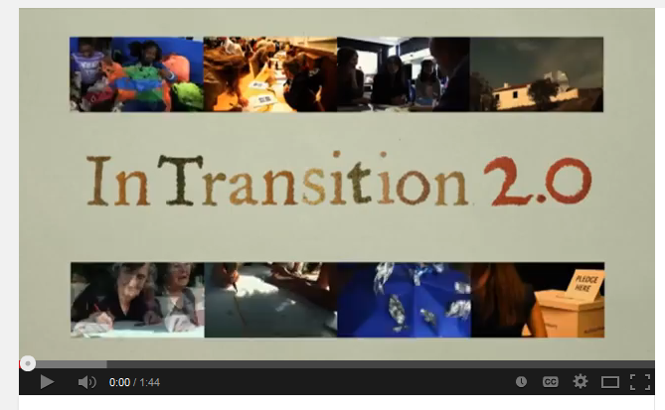
https://www.youtube.com/watch?v=CdqTuhvY-D0

Slide 52
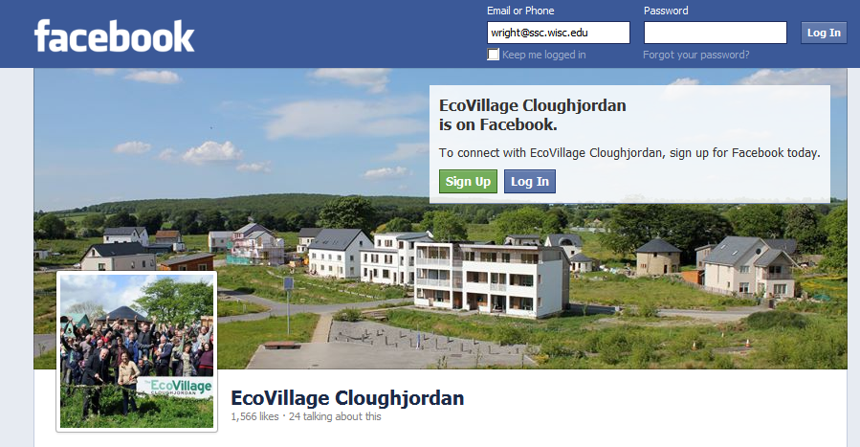
https://www.facebook.com/EcoVillageCjn

Slide 53
Task 3. Alternatives
What do all of these examples
have in common?
They all contribute to a more democratic and egalitarian distribution of power over the allocation, accessibility and use of resources than in capitalism.

Slide 54
Task 3. Alternatives
What do all of these examples
have in common?
They all embody, in varying degrees, the values of equality, democracy, community and sustainability to a greater extent than does capitalism.

Slide 55
Task 4. Transformation
Two classic visions of challenging capitalism
Taming capitalism
Smashing capitalism
Transcending capitalism

Slide 56
Task 4. Transformation
Two classic visions of challenging capitalism
Taming capitalism
Smashing capitalism
Transcending capitalism

Slide 57
Task 4. Transformation
Two classic visions of challenging capitalism
Taming capitalism
Smashing capitalism
Transcending capitalism

Slide 58
Task 4. Transformation
And a third…. And a Third…..
Taming capitalism
Smashing capitalism
Eroding capitalism

Slide 59
Task 4. Transformation
Contrasting Images of Social Systems
Organic system: society is like an organism
Ecosystem: society is like a pond

Slide 60
Task 4. Transformation
One final question
Could the expansion and deepening of these (and other) real utopia examples ever cumulatively erode the dominance of capitalism? Are they doomed to remain on the fringes, in small niches, leaving capitalist power hegemonic?

Slide 61
Task 4. Transformation
One final question
Could the expansion and deepening of these (and other) real utopia examples ever cumulatively erode the dominance of capitalism? Are they doomed to remain on the fringes, in small niches, leaving capitalist power hegemonic?

Slide 62
CONCLUSIONS
Real utopias are both a goal and a strategy
Democratization is at the core of transcending capitalism.
Institutional pluralism and heterogeneity: the idea of a “democratic economy” is realized in many different institutional forms.
Strategic indeterminacy: there is no one way
Opacity of the future limits of possibility: We cannot know in advance how far we can go in building alternatives within capitalism that push us beyond.

Slide 63
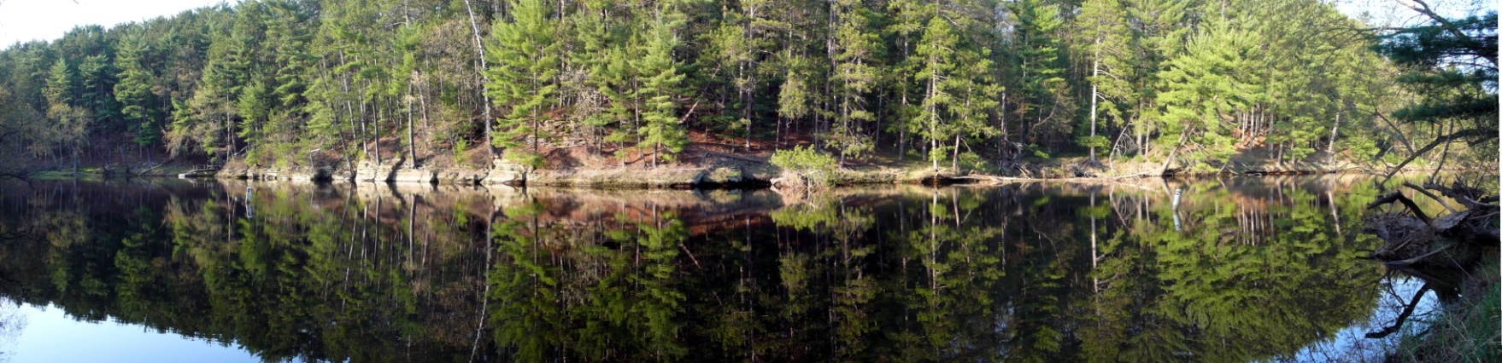
RadFest 2014
A gathering in the woods of Activists & Academics
Upham Woods
[near Wisconsin Dells, Wisconsin]
May 23-25, 2014
The RadFest Motto
If there is a conversation you will regret not having,
give it a name and we will schedule it.

