Slide 1
The Story of
L’ll Abner & the Shmoo

Slide 11
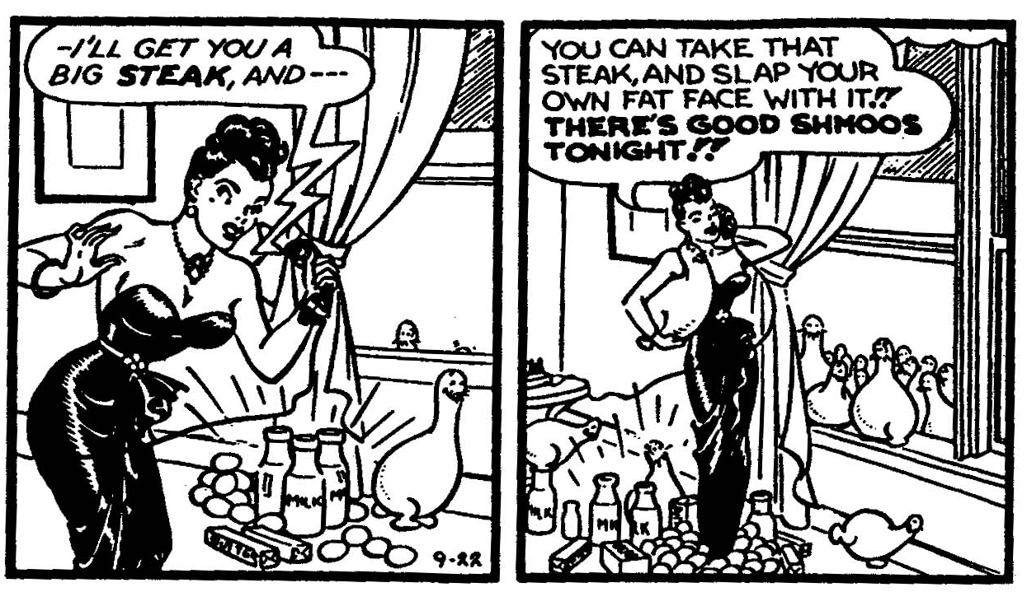

Slide 12
Rank ordering of Preferences of Different Classes for the Fate of the Shmoos
Capitalist Class (the rich) | Working Class (the poor)
1. Only capitalists get shmoos | 1. Everyone gets a shmoo
2. Destroy the shmoos | 2. Only workers get shmoos
3. Everyone gets a shmoo | 3. Only capitalists get shmoos
4. Only workers get shmoos | 4. Destroy the shmoos

Slide 13
Three Criteria for Defining “Exploitation”
Inverse Interdependent Welfare Principle
The material welfare of the advantaged group of people causally depends upon the material deprivations of the disadvantaged.
(b) The Exclusion Principle
The causal relation in (a) involves the exclusion of the disadvantaged group from access to certain important productive resources controlled by the advantaged group.
(c) The Labor Appropriation Principle
The causal mechanism which translates (b) exclusion into (a) differential welfare involves the appropriation of the fruits of labor of the disadvantaged group by those who control these productive resources.
Non-exploitative Oppression = (a) + (b)
Exploitation = (a) + (b) + (c)

